Slide 1
GENPACT
End-to-End Salient Object Detection
Custom CNN built from scratch for visually dominant object segmentation
PyTorch
ECSSD
Encoder–Decoder CNN
Gradio Demo
Project outcome
A functioning model and demo that take an input image and produce a saliency mask with overlay visualization.
End-to-End Salient Object Detection | Academic Project
1

Slide 2
GENPACT
Data Pipeline
ECSSD dataset prepared for binary saliency-mask prediction.
1
Load image + mask
2
Resize
3
Normalize
4
Split
RGB image and grayscale ground-truth mask
All samples resized to 224 × 224
Images converted to tensor and normalized; masks remain 0–1
70% Train · 15% Validation · 15% Test
Augmentation
Why it matters
Data split
Horizontal flip, random crop, brightness variation, and contrast variation are applied to training images only.
Augmentation helps the model generalize to object position, crop, and lighting changes instead of memorizing the dataset.
Train: 700 | Validation: 150 | Test: 150
End-to-End Salient Object Detection | Academic Project
2

Slide 3
GENPACT
Model Architecture & Training
Custom encoder-decoder CNN trained from scratch without pre-trained weights.
Encoder
Bottleneck
Decoder
Output
4 Conv blocks Conv2D + BatchNorm + ReLU MaxPooling for downsampling
512-channel deep representation Dropout2d(0.3) for regularization
4 ConvTranspose2D blocks Upsampling + skip connections Reconstructs spatial mask detail
1-channel mask Sigmoid activation Same 224 × 224 dimensions
Training configuration
Checkpointing
Loss = Binary Cross-Entropy + 0.5 × (1 − IoU) Optimizer = Adam Final training used a lower learning rate for stability Early stopping monitors validation loss
Best model saved as checkpoints/best_model.pth Checkpoint stores model weights, optimizer state, epoch, and validation loss Supports reliable training continuation logic
End-to-End Salient Object Detection | Academic Project
3

Slide 4
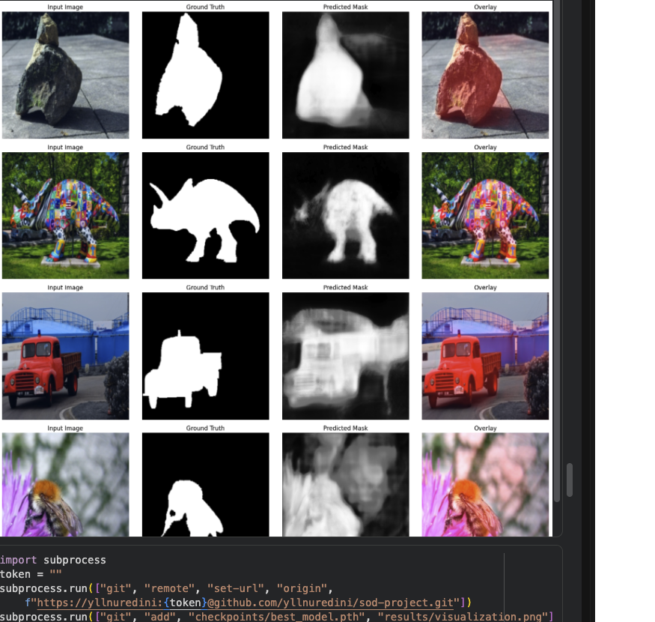
GENPACT
Evaluation Results & Visual Output
The best checkpoint was evaluated on the held-out ECSSD test set.
0.5837
0.7040
0.8038
IoU
Precision
Recall
0.7121
0.1957
4.73 ms/image
F1-Score
MAE
Avg. inference
Interpretation
The model achieves strong recall, meaning it detects most salient regions. IoU and MAE show there is still room to improve boundary sharpness and reduce background noise.
Input image · Ground truth · Predicted mask · Overlay
End-to-End Salient Object Detection | Academic Project
4

Slide 5
GENPACT
Demo App & Final Takeaways
The project is packaged as a working SOD pipeline with an interactive demo.
Demo interaction
Displayed outputs
Tools
Gradio app accepts a user-uploaded image, preprocesses it to 224 × 224, runs inference, and returns the saliency output.
The app returns the predicted saliency mask, overlay visualization, and inference time for each image.
Python 3.9+ · PyTorch · OpenCV · NumPy · Matplotlib · scikit-learn · tqdm · Gradio
• Complete SOD workflow implemented from data loading to demo deployment.
• Custom CNN architecture trained without pre-trained weights.
• Evaluation combines quantitative metrics with visual inspection.
• Future work: train longer, tune thresholds, add stronger decoder/attention modules, and compare against a true baseline run.
Built as a practical computer vision project aligned with data, AI, and advanced technology work.
End-to-End Salient Object Detection | Academic Project
5

